Slide 1


Project 1 -Currency Analysis
Kane
Damien
Paris

Slide 2
Content
About this project
Analysis of currency pairs
Trading advise

Slide 3
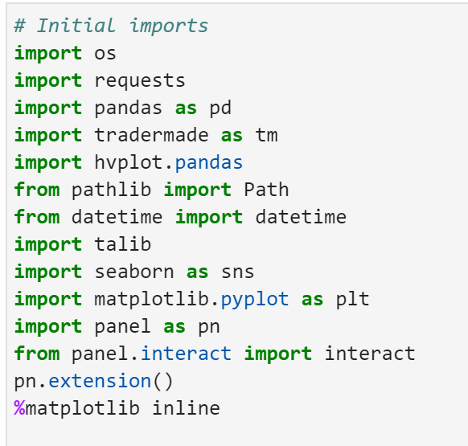
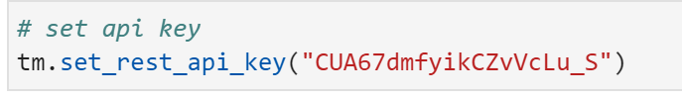
About this project
Attempting to create a momentum strategy by using historical data, the RSI indicator, and comparing the selected currency pair with come other top traded currency pairs using the same base currency
Key pairs we are using:
EUR/USD; GBP/USD; CAD/USD; AUD/USD; NZD/USD
Datasets and API we to be used : Pandas, Numpy, Hvplot, TaLib, Matplotlib, Path, API will be from tradermade

Slide 4

About this project
We have used tradermate, the main currency pair we focused on was AUDUSD solved by extracting 12 months data from the last trading day using daily data, from that we sliced the data to give us 6 month and 3 month trends, as well as retrieving 1 month data using hourly data. We correlated this with NZD, CAD, EUR, GBP to find any similarities and/or patterns.

Slide 5

Damien Jennings

Slide 6
About this project
What steps were taken to build the app?
Registered for API key, read and understood API/SDK documentation. Pulled the data into the code. We saved the data into a CSV file so that we were not pulling as much data due to limited access on the API. We also did this in case we lost any data, we were still able to run our program. We created visual charts to see overall patterns and trends of the pairs, calculated daily returns and correlation. Also showed descriptive statistics to get an overall view of AUDUSD. We used the python library Talib to run an RSI measure on our yearly data to be able to give us a buy, hold or sell signal. The strategy is well known and widely used, being if the RSI gets over ‘70, it is over bought and its time to sell, and if it falls below 30, its over sold and time to sell.

Slide 7
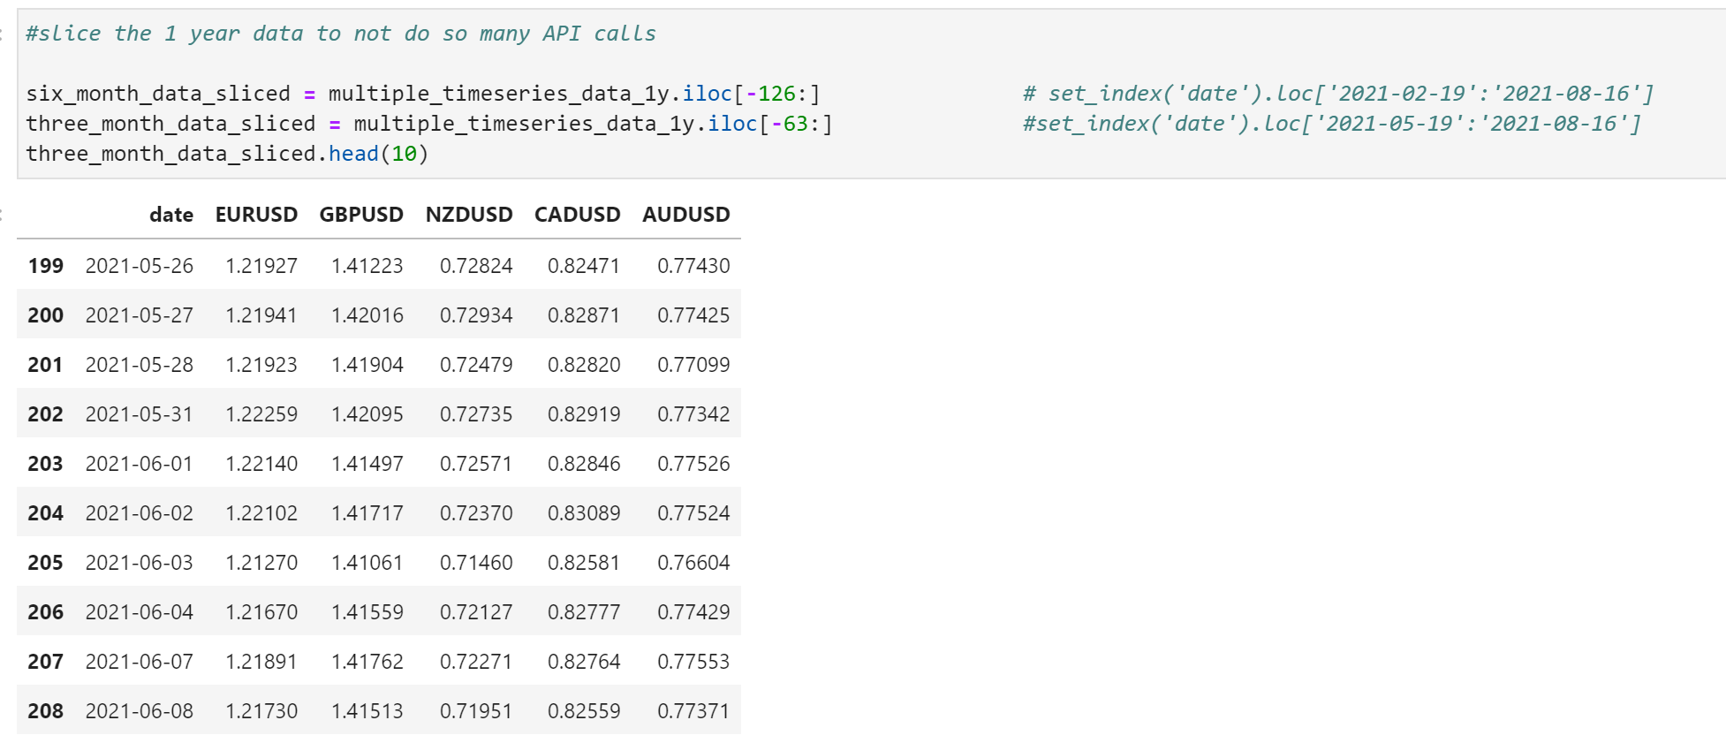
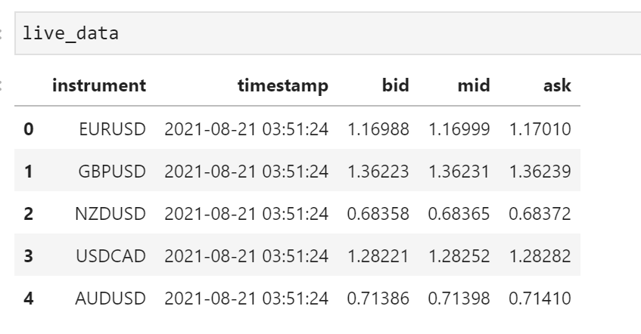
Data Formatting

Slide 8
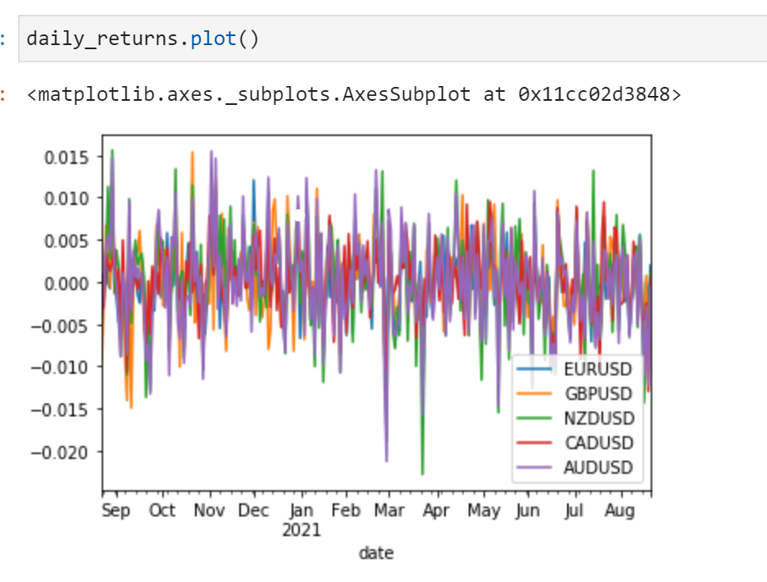

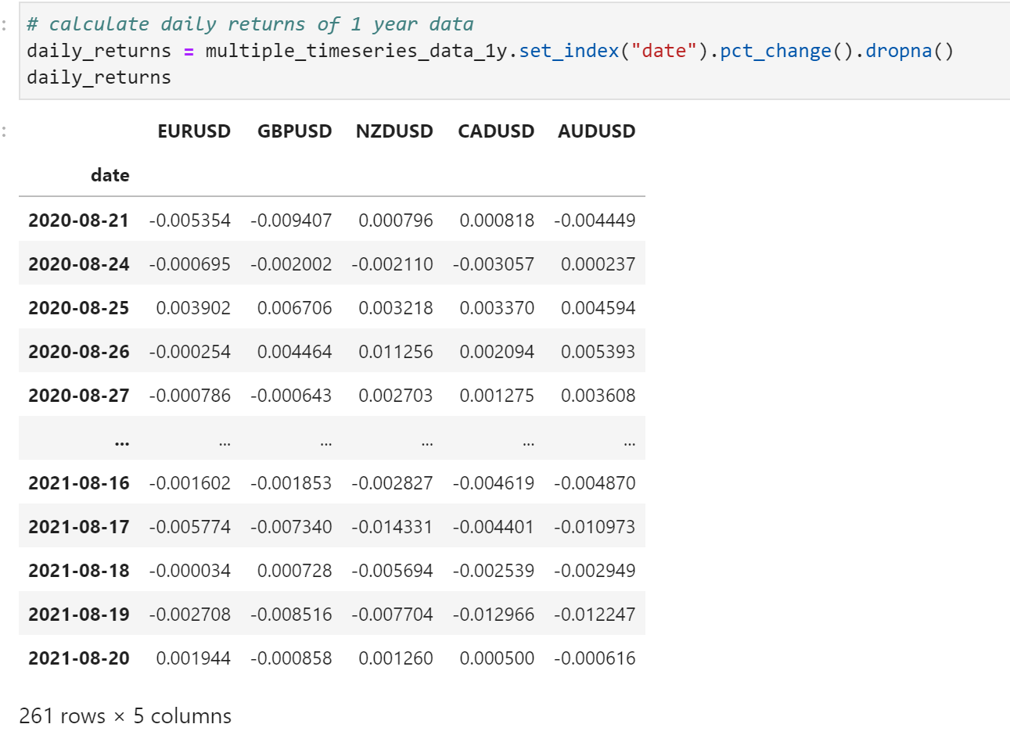
Correlation: by computing daily returns
Analysis of Currency Pairs

Slide 9
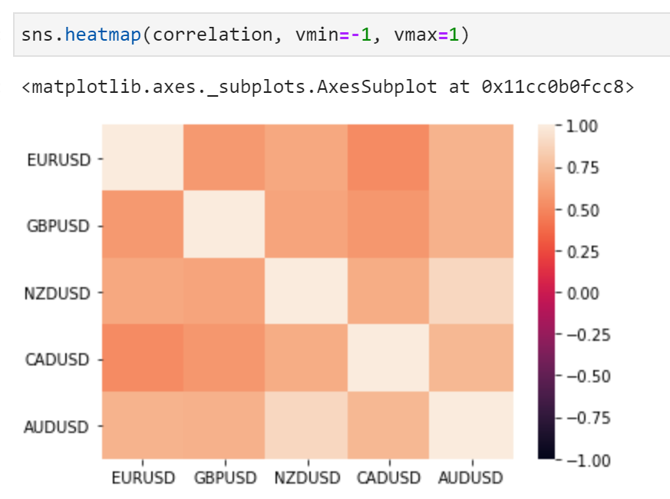
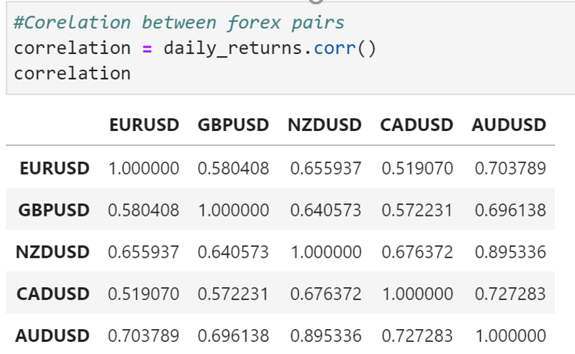
Correlation: Highest correlated with AUD—— NZD Least correlated with AUD——GBP, EUR
Analysis of Currency Pairs

Slide 10
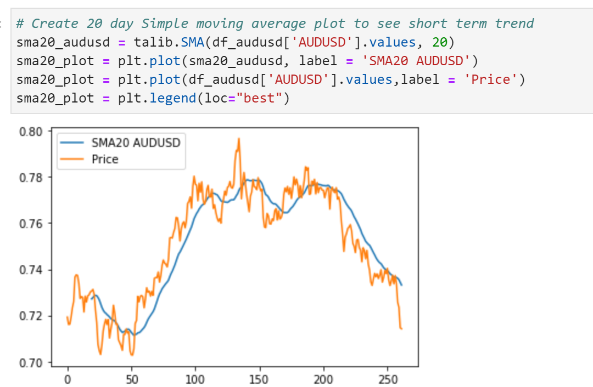
Analysis of Currency Pairs
Short term trend analysis

Slide 11

Kane Moore

Slide 12
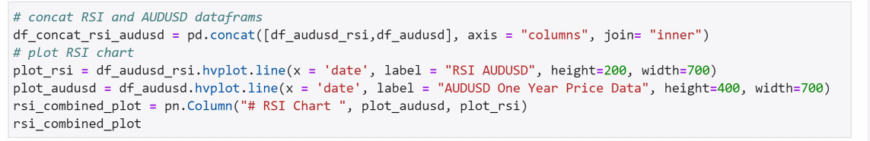
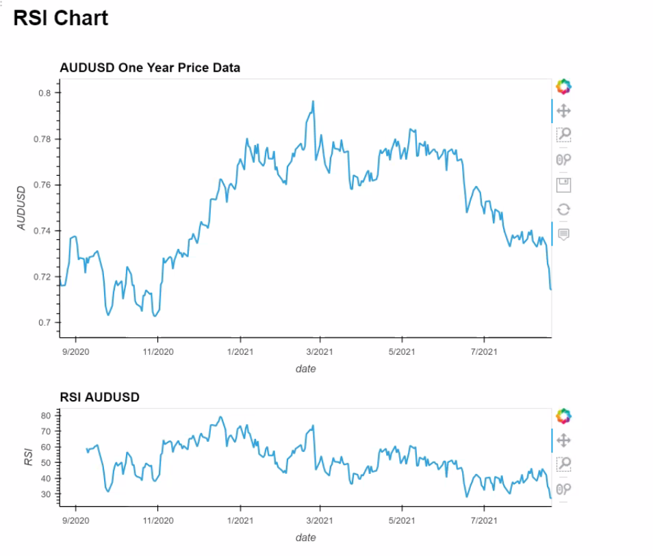
Analysis of Currency Pairs
RSI

Slide 13

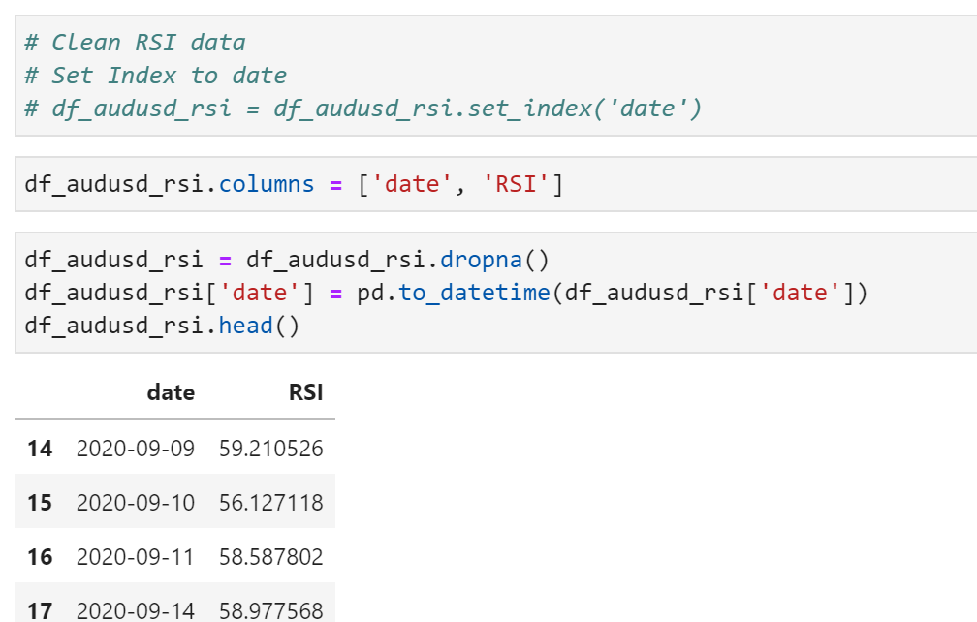
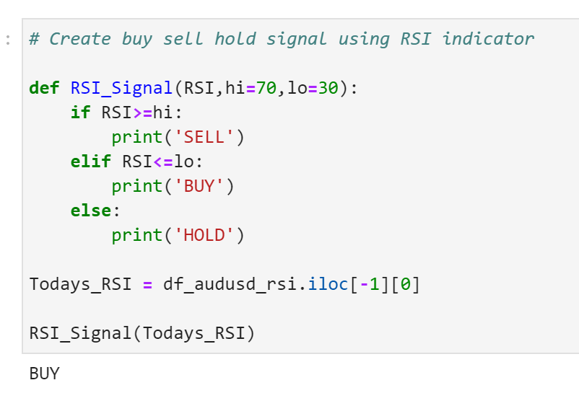
Trading advise
If we set the trading signal as high limit=70%, low limit=30%, according to the signal using RSI indicator, we would ‘buy’

Slide 14

Thanks for listening

